Slide 1
Assessing Reliability of Annotations in the Context of Model Predictions and Explanations
Hadi Mohammadi Pablo Mosteiro Anastasia Giachanou
Massimo Poesio
Department of Methodology and Statistics,
Utrecht University,
The Netherlands.
May 31, 2024

Slide 2
Tasks Overview & Dataset
EXIST shared tasks
5,000 tweets in two different languages
TASK 1 - Sexism Identification
TASK 2 - Source intention classification
TASK 3 - Sexism Categorization
Task 3 | Task 2 | Task 1 | Annotators' Info | Number of Items | Language | Exist 2024
Objectification | Reported | Sexism Detection | Gender | Train: 3260 (en) Train: 3660 (es) Total: 6920 | English (en)
Stereotyping and Dominance | Judgmental |  | Age | Dev: 489 (en) Dev: 549 (es) Total: 1038 | Spanish (es)
Ideological and inequality | Direct |  | ethnicities | Test: 978 (en) Test: 1098 (es) Total: 2076
Sexual violence |  |  | Study levels
Misogyny and non-sexual violence |  |  | Countries

Slide 3
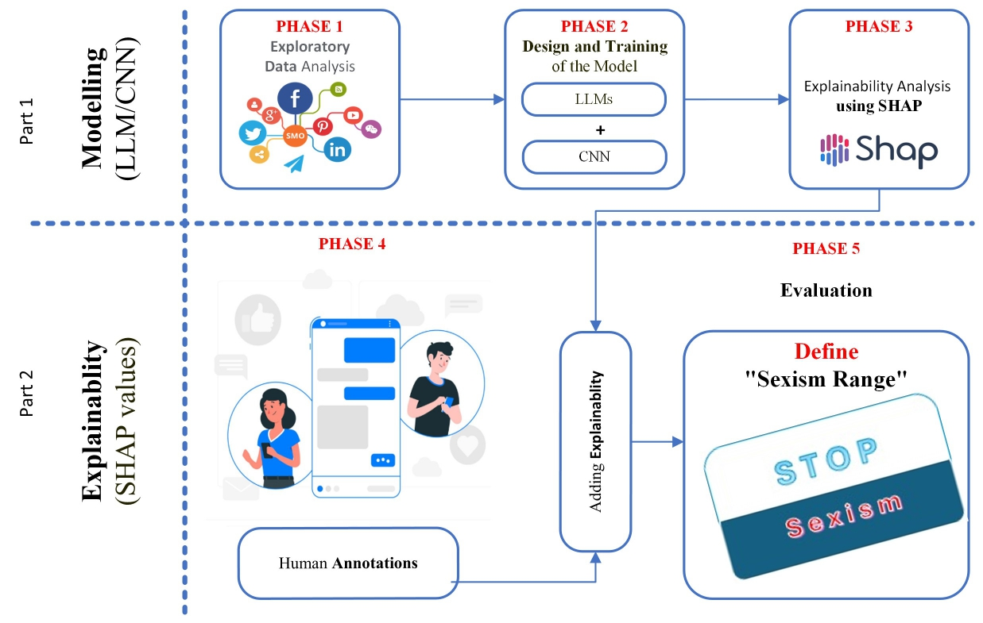
Research Methodology
The BERT models is employed on this project for prediction.
SHAP is used to identify influential tokens or phrases for generating explanations.
An A/B testing framework is established to evaluate the impact of model explanations on annotator agreement.

Slide 4
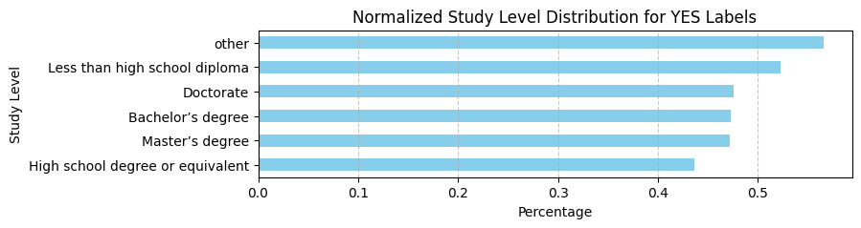
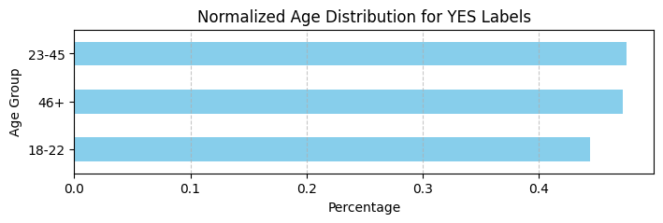
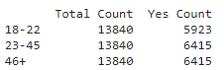
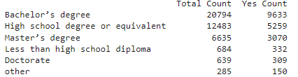
Exploratory Data Analysis (EDA)
Annotator’s Age
Annotator’s Study level
Normalized Age Distribution for YES Labels:
The highest percentage of "YES" labels is in the age groups 23-45 and 46+ (both 46.35%).
The 18-22 age group has a slightly lower percentage (42.80%).
Normalized Study Level Distribution for YES Labels:
The highest percentage of "YES" labels is seen in "Other" study levels (52.63%).
The lowest percentage is for "High school degree or equivalent" (42.13%).

Slide 5
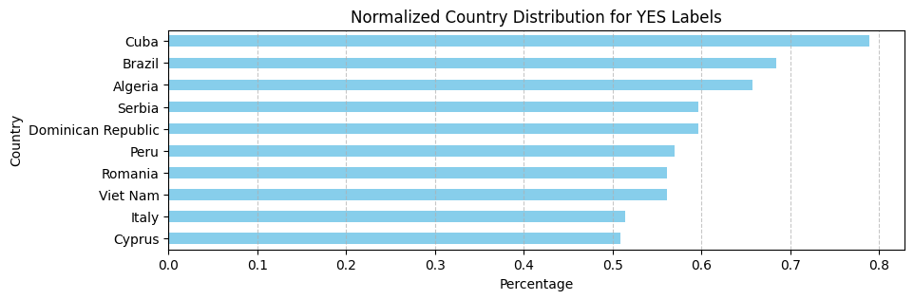
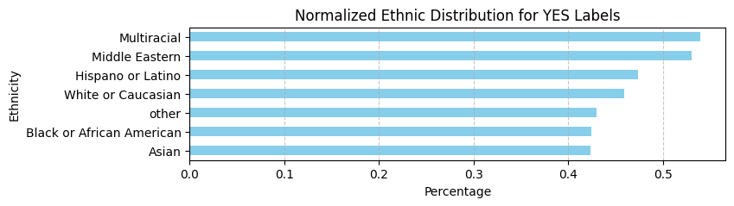
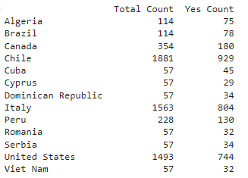
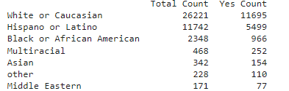
Exploratory Data Analysis (EDA)
Annotator’s Country
Annotator’s Ethnicity
Normalized Country Distribution for YES Labels:
Cuba has the highest percentage of "YES" labels (78.95%), followed by Brazil (68.42%).
Macedonia has the lowest percentage (14.04%).
Normalized Ethnic Distribution for YES Labels:
Multiracial has the highest percentage of "YES" labels (53.85%).
The lowest percentage is seen in Black or African American (41.14%).

Slide 6
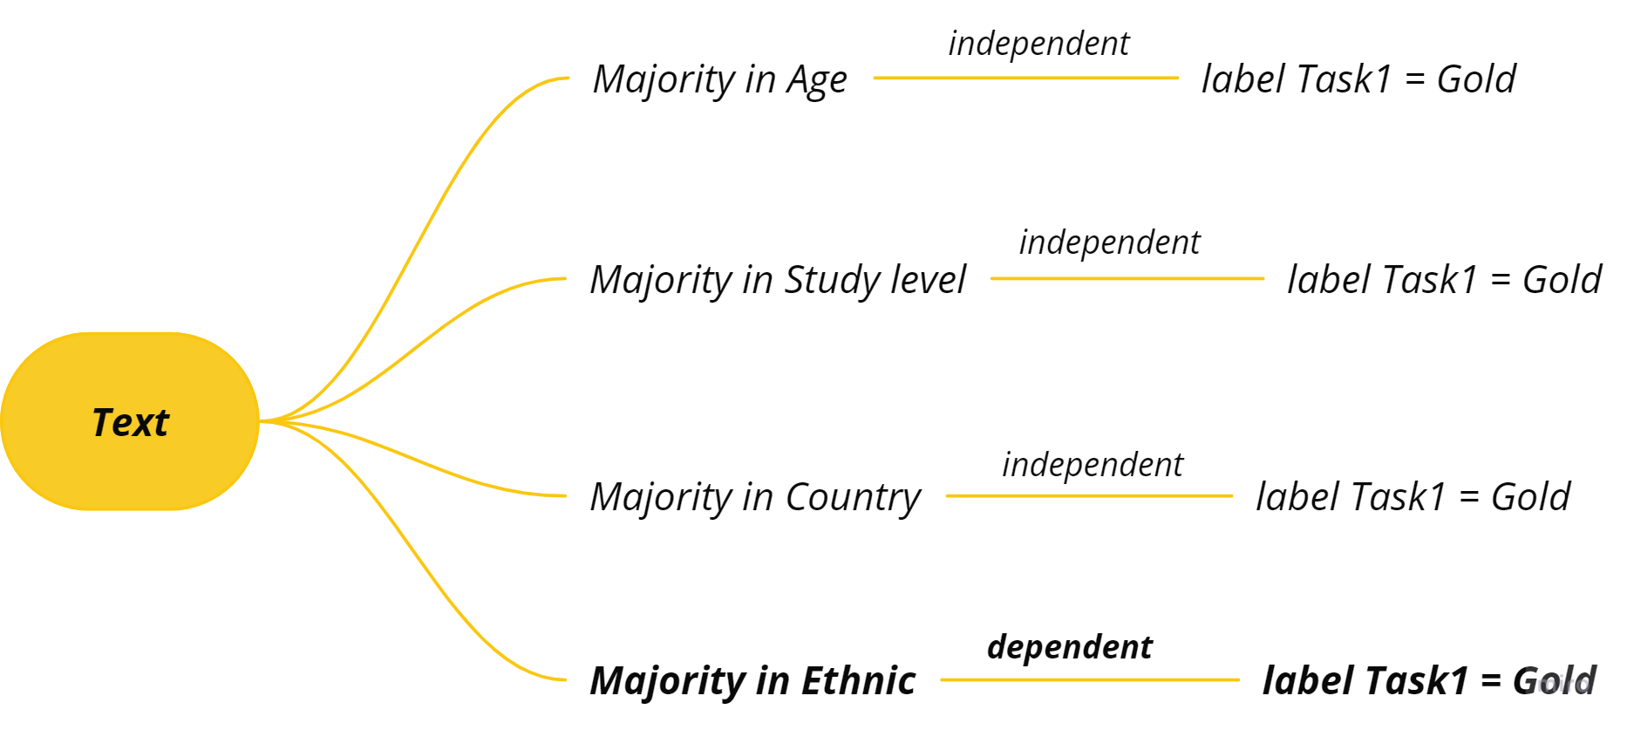
Exploratory Data Analysis (EDA)
Hypothesis tests
Null Hypothesis (H0): Distribution of majority in age group; study levels; countries; ethnicities is independent with all annotator’s agreement.
Alternative Hypothesis (H1): Distribution of majority in age group; study levels; countries; ethnicities is dependent with all annotator’s agreement.
Significance (alpha = 0.05) | p-value | Chi-square Statistic | Hypothesis | Level of Agreement vs.
Not Significant | 0.326 | 6.948 | Majority Age Group
Not Significant | 0.833 | 2.806 | Majority Level of Study
Not Significant | 0.934 | 54.812 | Majority Country
Significant | 0.020 | 14.979 | Majority Ethnicity

Slide 7
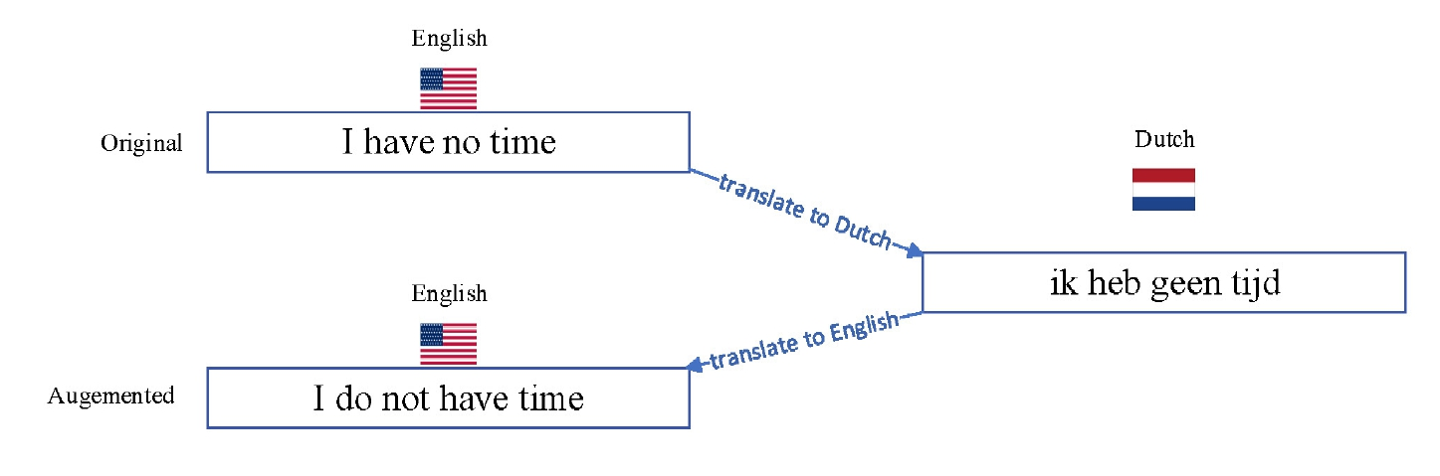
Data Augmentation Techniques
Synonym augmentation Word swapping, insertion,
substitution, deletion Introducing spelling variations
Back translation techniques: English ¡-¿ Dutch

Slide 8
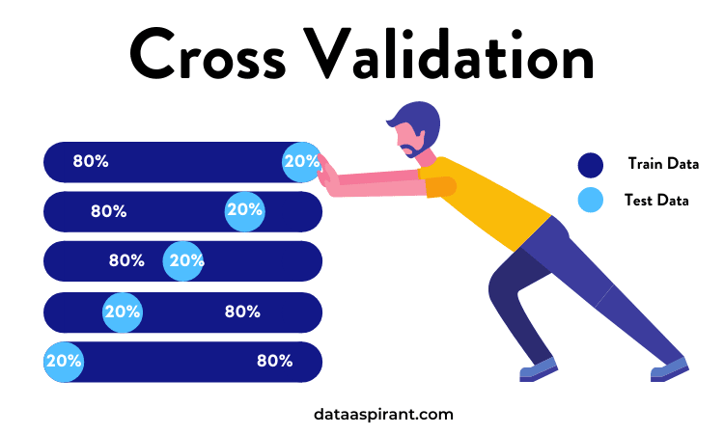
Cross-Validation Data Preparation
Utilize StratifiedKFold
Address class imbalance:
RandomOverSampler
SMOTE
Compute class weights for balanced training.

Slide 9
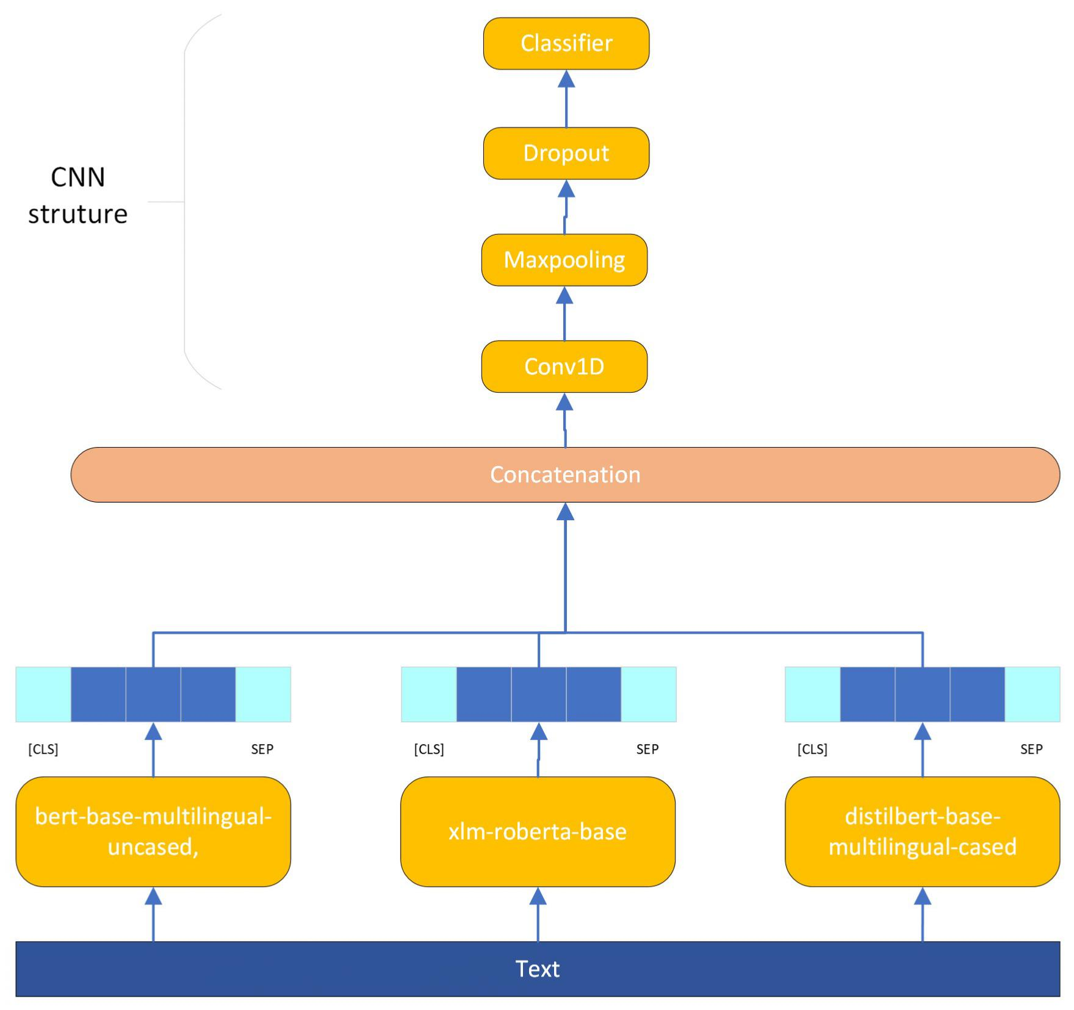
Ensemble Model Design
Build and fine-tune sequence classification BERT model using:
bert-base-multilingual-cased
xlm-roberta-base
distilbert-base-multilingual-cased.
CNN structure with a Conv1D and a Classification layer.
Adding Explainablity with SHAP and Human ranking.

Slide 10
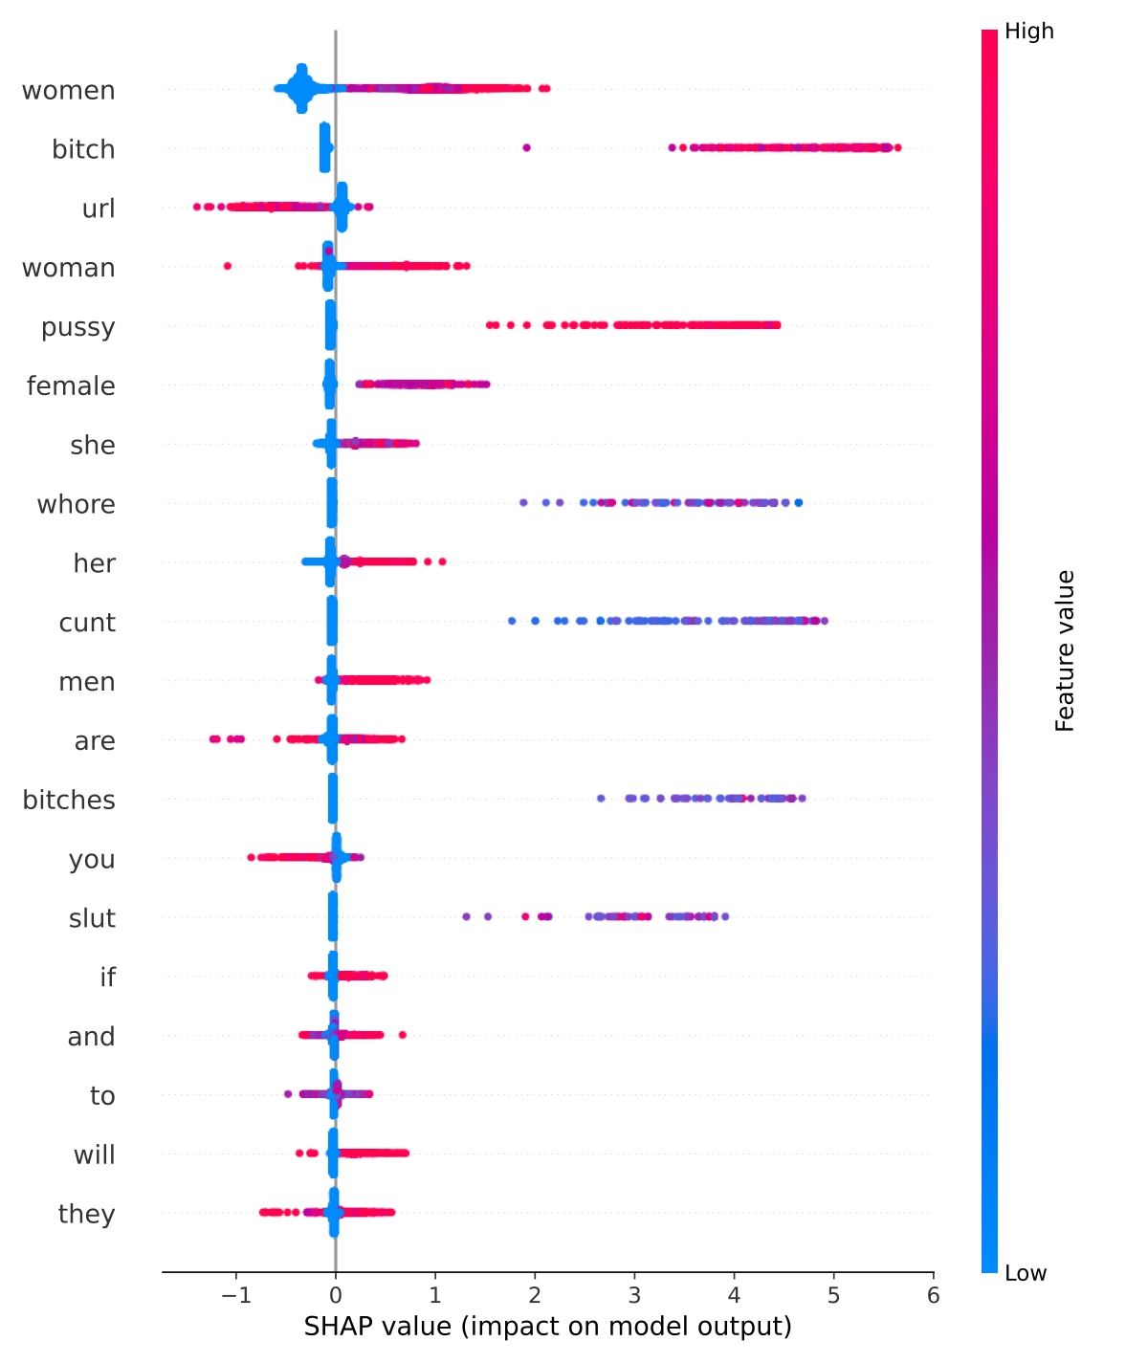
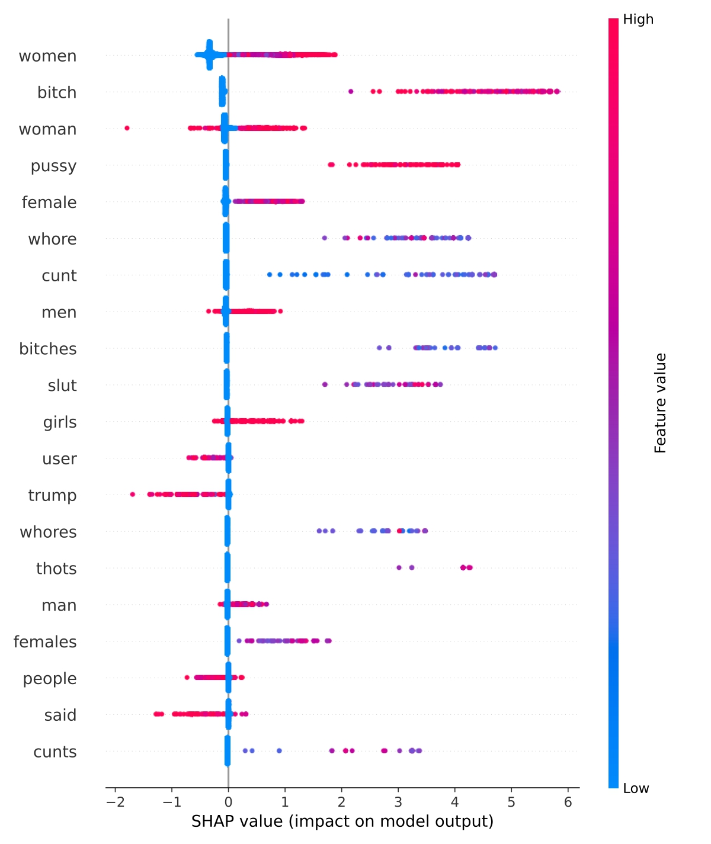
Integration of Human Rationalization
Combines SHAP insights with human analysis.
Re-ranking of tokens based on their impact on sexism classification.
Use of a 0 to 1 scale to blend human judgment with algorithmic insights.
Pre and post-human rationalization comparison

Slide 11
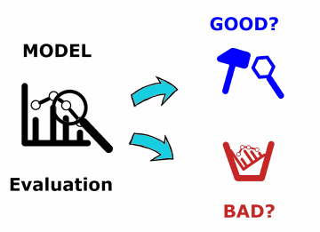
Model Training & Optimization
Used Adam Optimizer with a learning rate of 3 × 10−5
Incorporated a 200-step warm-up and early stopping to prevent overfitting.
Mixed precision training for efficiency.
Tokenization limited to 512 tokens.
Hyperparameters determined by random search and Keras Tuner.
Learning rate followed a cosine decay schedule.

Slide 12
Experimentation & Results
Accurate non-sexist classification in both scenarios.
Detected subtle sexism effectively with human rationalization.
Model closely mirrors human logic in detecting sexism.

Slide 13
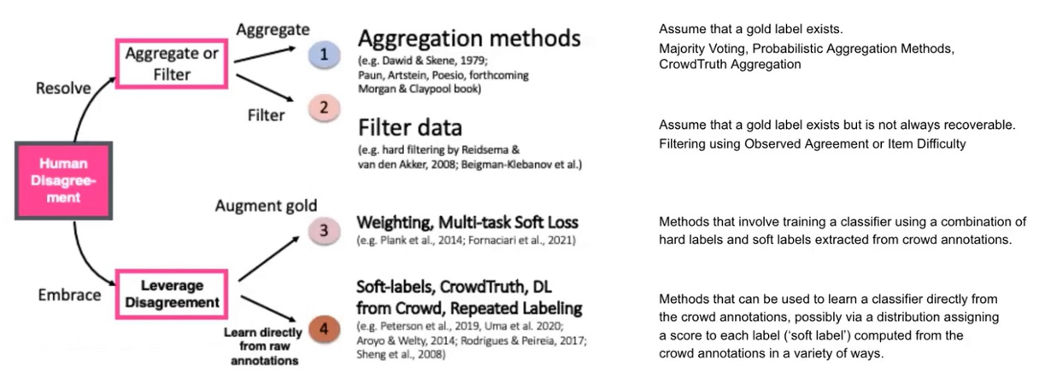
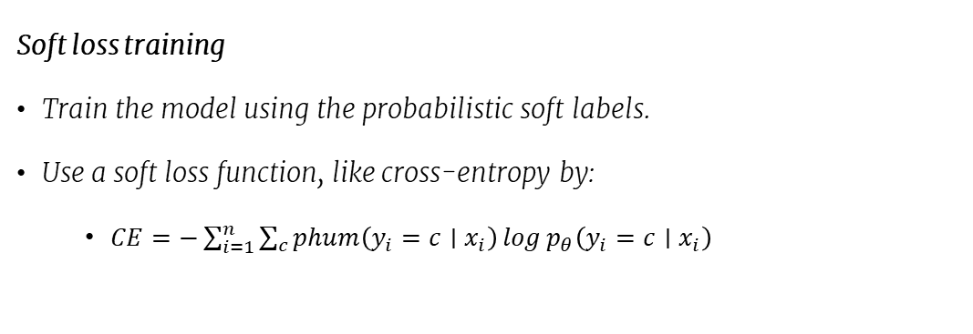
Learning with disagreement.
Soft loss training
Train the model using the probabilistic soft labels.
Use a soft loss function, like cross-entropy by:
$CE=−\sum_{i=1}^{n}{\sum_{c}{\operatorname{phum}\left(y_{i}=c∣x_{i}\right)\log{p_{θ}\left(y_{i}=c∣x_{i}\right)}}}$
Uma, A. N., Fornaciari, T., Hovy, D., Paun, S., Plank, B., & Poesio, M. (2021). Learning from disagreement: A survey. Journal of Artificial Intelligence Research, 72, 1385-1470.

Slide 14
Thank You!
Thank you for your attention!
For further questions or details, please contact:
h.mohammadi@uu.nl
https://hadimohammadi.info/

